Slide 1
User Interaction and Navigation
Android Developer Fundamentals
Lesson 4

Slide 2
User Input Controls

Slide 3
Contents
User Interaction
Focus
Text input and keyboards
Radio Buttons and Checkboxes
Making Choices
dialogs, spinners and pickers
Recognizing gestures

Slide 4
User Interaction

Slide 5

Users expect to interact with apps
Clicking, pressing, talking, typing, and listening
Using user input controls such buttons, menus, keyboards, text boxes, and a microphone
Navigating between activities
User Input Controls
This work is licensed under a Creative Commons Attribution-NonCommercial 4.0 International License
Android Developer Fundamentals

Slide 6
User interaction design
Important to be obvious, easy, and consistent:
Think about how users will use your app
Minimize steps
Use UI elements that are easy to access, understand, use
Follow Android best practices
Meet user's expectations
User Input Controls
This work is licensed under a Creative Commons Attribution-NonCommercial 4.0 International License
Android Developer Fundamentals

Slide 7
Input Controls

Slide 8
Ways to get input from the user
Free form
Text and voice input
Actions
Buttons
Contextual menus
Gestures
Dialogs
Constrained choices
Pickers
Checkboxes
Radio buttons
Toggle buttons
Spinners

Slide 9
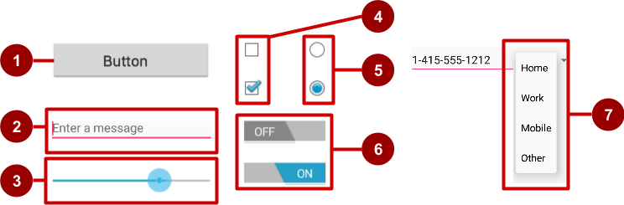
Examples of user input controls
Button
Text field
Seek bar
Checkboxes
Radio buttons
Toggle
Spinner

Slide 10
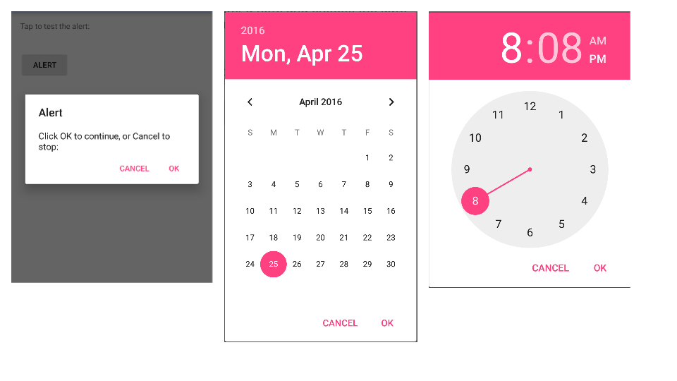
Alert dialog, date picker, time picker

Slide 11
View is base class for input controls
The View class is the basic building block for all UI components, including input controls
View is the base class for classes that provide interactive UI components
View provides basic interaction through android:onClick

Slide 12
Focus

Slide 13
Focus
The view that receives user input has "Focus"
Only one view can have focus
Focus makes it unambiguous which view gets the input
Focus is assigned by
User tapping a view
App guiding the user from one text input control to the next using the Return, Tab, or arrow keys
Calling requestFocus() on any view that is focusable

Slide 14
Clickable versus focusable
Clickable—View can respond to being clicked or tapped
Focusable—View can gain focus to accept input
Input controls such as keyboards send input to the view that has focus

Slide 15
Which View gets focus next?
Topmost view under the touch
After user submits input, focus moves to nearest neighbor—priority is left to right, top to bottom
Focus can change when user interacts with a directional control

Slide 16
Guiding users
Visually indicate which view has focus so users knows where their input goes
Visually indicate which views can have focus helps users navigate through flow
Predictable and logical—no surprises!

Slide 17
Guiding focus
Arrange input controls in a layout from left to right and top to bottom in the order you want focus assigned
Place input controls inside a view group in your layout
Specify ordering in XML
android:id="@+id/top"
android:focusable="true"
android:nextFocusDown="@+id/bottom"

Slide 18
Set focus explicitly
Use methods of the View class to set focus
setFocusable() sets whether a view can have focus
requestFocus() gives focus to a specific view
setOnFocusChangeListener() sets listener for when view gains or loses focus
onFocusChanged() called when focus on a view changes

Slide 19
Find the view with focus
Activity.getCurrentFocus()
ViewGroup.getFocusedChild()

Slide 20
Text Input

Slide 21
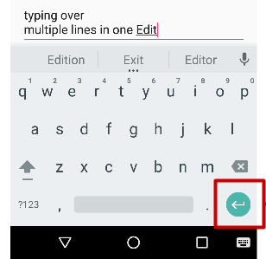
EditText
EditText class
Multiple lines of input
Characters, numbers, and symbols
Spelling correction
Tapping the Return (Enter) key starts a new line
Customizable
"Action" key

Slide 22
Getting text
Get the EditText object for the EditText view
EditText simpleEditText = (EditText) findViewById(R.id.edit_simple);
Retrieve the CharSequence and convert it to a string
String strValue = simpleEditText.getText().toString();

Slide 23
Input types
Common input types
textShortMessage—Limit input to 1 line
textCapSentences—Set keyboard to caps at beginning of sentences
textAutoCorrect—Enable autocorrecting
textPassword—Conceal typed characters
textEmailAddress—Show an @ sign on the keyboard
phone—numeric keyboard for phone numbers
android:inputType="phone"
android:inputType="textAutoCorrect|textCapSentences"

Slide 24
Responding to button taps
In your code: Use OnClickListener event listener.
In XML: use android:onClick attribute in the XML layout:
<Button
android:id="@+id/button_send"
android:layout_width="wrap_content"
android:layout_height="wrap_content"
android:text="@string/button_send"
android:onClick="sendMessage" />
android:onClick
Notes:
A click event occurs when the user taps or clicks a button, or an image used as a button. The object notifies an event listener called OnClickListener, which is an interface in the View class. You can use the listener to respond to a click event.
Android Studio provides a shortcut for setting up an OnClickListener for the clickable object in your Activity code, and for assigning a callback method: use the android:onClick attribute with the clickable object’s element in the XML layout. For example:
<Button
android:id="@+id/button_send"
android:layout_width="wrap_content"
android:layout_height="wrap_content"
android:text="@string/button_send"
android:onClick="sendMessage" />
In this case, when a user clicks the button, the Android system calls the Activity’s sendMessage() method.

Slide 25
Buttons

Slide 26
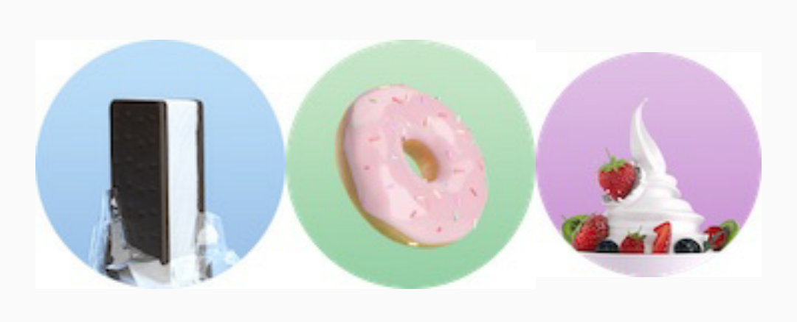

Button
View that responds to clicking or pressing
Usually text or visuals indicate what will happen when it is pressed
Views: Button > ToggleButton, ImageView > FloatingActionButton (FAB)
State: normal, focused, disabled, pressed, on/off
Visuals: raised, flat, clipart, images, text

Slide 27
Setting listener with onClick callback
Button button = (Button) findViewById(R.id.button);
button.setOnClickListener(new View.OnClickListener() {
public void onClick(View v) {
// Do something in response to button click
}
});

Slide 28
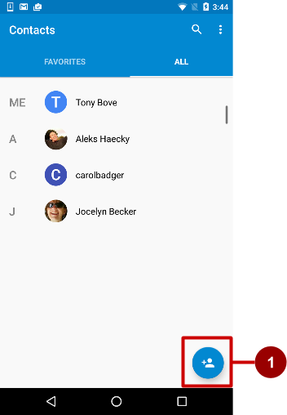
Floating Action Buttons (FAB)
Raised, circular, floats above layout
Primary or "promoted" action for a screen
One per screen
For example:
Add Contact button in Contacts app

Slide 29
Using FABs
Add design support library to build.gradle
compile 'com.android.support:design:a.b.c’
Latest:
implementation 'com.google.android.material:material:1.2.0-alpha04'
Layout
<android.support.design.widget.FloatingActionButton
android:id="@+id/fab"
android:layout_gravity="bottom|end"
android:layout_margin="@dimen/fab_margin"
android:src="@drawable/ic_fab_chat_button_white"
.../>

Slide 30
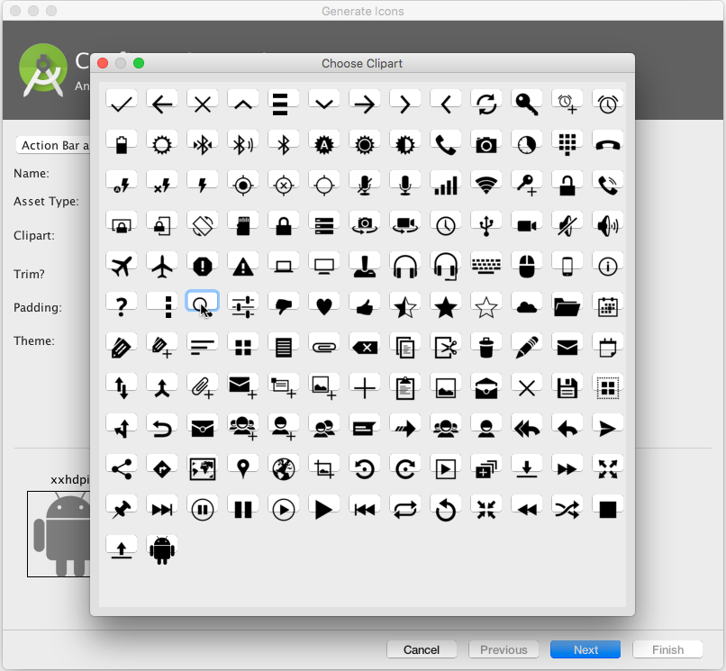
Button image assets
Right-click app/res/drawable
Choose New > Image Asset
Choose Action Bar and Tab Items from drop down menu
Click the Clipart: image (the Android logo)
Experiment:
Choose New > Vector Asset

Slide 31
Demo of Floating Action Button
Add dependencies
Create a FAB in the activity_main.xml
Create images asset to add to FAB
In Main_Activity.java extract the FAB view and add listerner to perform the action.

Slide 32
Animation
Animation is the process of creating motion and shape change.
Animation in android is possible from many ways. one easy and widely used way of making animation called tweened animation is discussed here.

Slide 33
Resources
In resources create an animation file res->anim->.xml
File is with .xml format
Need to add the animation codes for scale or rotate etc.
Scale, Rotate, Alpha,Translate

Slide 34
Scale
<scale xmlns:android="http://schemas.android.com/apk/res/android"
android:fromXScale="0.5"
android:toXScale="3.0"
android:fromYScale="0.5"
android:toYScale="3.0"
android:duration="5000"
android:pivotX="50%"
android:pivotY="50%" >
</scale>

Slide 35
Rotate
<rotate xmlns:android="http://schemas.android.com/apk/res/android"
android:fromDegrees="0"
android:toDegrees="360"
android:pivotX="50%"
android:pivotY="50%"
android:duration="5000" >
</rotate>

Slide 36
Fading
Appear:
<alpha android:fromAlpha="0"
android:toAlpha="1“
android:duration="2000" >
</alpha>
Disappear:
<alpha android:startOffset="2000“
android:fromAlpha="1“
android:toAlpha="0"
android:duration="2000" >
</alpha>

Slide 37
Blink
<alpha android:fromAlpha="0.0"
android:toAlpha="1.0" android:interpolator="@android:anim/accelerate_interpolator"
android:duration="600"
android:repeatMode="reverse"
android:repeatCount="infinite"/>

Slide 38
Move
<translate android:fromXDelta="0%p"
android:toXDelta="75%p“
android:duration="800" />

Slide 39
Slide
<scale android:duration="500“
android:fromXScale="1.0"
android:fromYScale="1.0"
android:interpolator="@android:anim/linear_interpolator"
android:toXScale="1.0"
android:toYScale="0.0" />

Slide 40
Animation Object creation
Animation anim= AnimationUtils.loadAnimation(
getApplicationContext(),R.animation_file);
View.startAnimation(anim); //start animation with
animation object

Slide 41
Demo
Create an image, text and button.
Apply all animation features on the image,text and button.

Slide 42
Making Choices

Slide 43
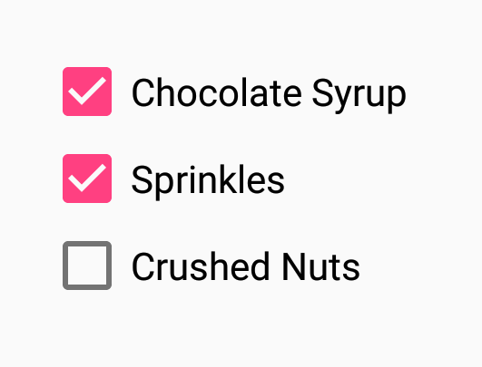
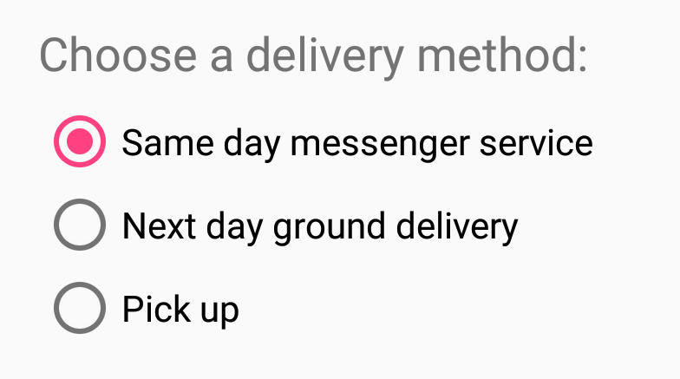

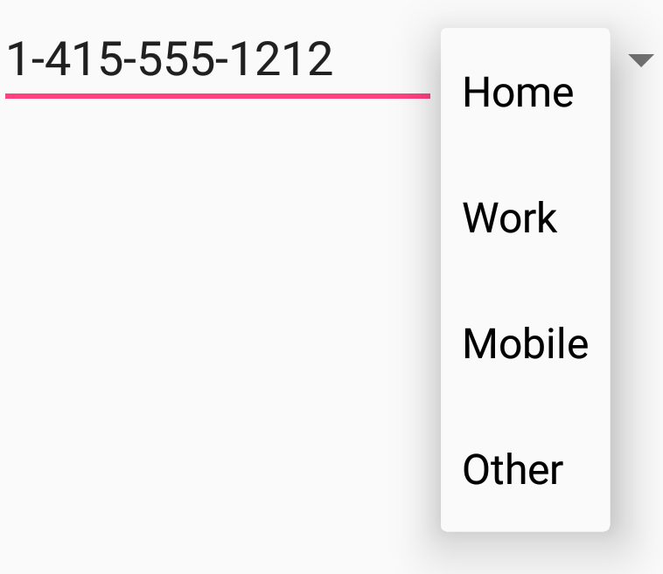

So many choices!
Checkboxes
Radio buttons
Toggles
Spinner

Slide 44
Checkboxes, radio buttons and toggles

Slide 45
Checkboxes
User can select any number of choices
Checking one box does not uncheck another
Users expect checkboxes in a vertical list
Commonly used with a submit button
Every checkbox is a view and can have an onClick handler

Slide 46
Radio buttons
User can select one of a number of choices
Put radio buttons in a RadioGroup
Checking one unchecks another
Put radio buttons in a vertical list or horizontally if labels are short
Every radio button can have an onClick handler
Commonly used with a submit button for the RadioGroup

Slide 47
Toggle buttons and switches
User can switch between 2 exclusive states (on/off)
Use android:onClick+callback—or handle clicks in code
Toggle buttons
Switches

Slide 48
Chip and ChipGroup

Slide 49
Chip
Chips are basically a text displayed in a rounded background. These are checkable and can contain icons as well. Chips are a newer and stylised form of RadioButton.
<com.google.android.material.chip.Chip style="@style/Widget.MaterialComponents.Chip.Choice" android:layout_width="wrap_content" android:layout_height="wrap_content"
app:chipText="Choice" />

Slide 50
Android ChipGroup
Similar to RadioGroups, ChipGroups are used to hold Chips
<com.google.android.material.chip.ChipGroup android:layout_width="wrap_content" android:layout_height="wrap_content" android:layout_marginTop="16dp">

Slide 51
ChipGroups
ChipGroups by default spaces the Chips present inside it.
Few of the XML attributes that can be used with ChipGroups are:
app:chipSpacing: To set a custom spacing value between the chips, both horizontally and vertically.
app:chipSpacingHorizontal
app:chipSpacingVertical
app:singleSelection – Setting this as true allows only one of the chips to be checked.
app:singleLine – Sets all the chips present, in a single line only.

Slide 52
Spinners

Slide 53
Spinners
Quick way to select value from a set
Drop-down list shows all values, user can select only one
Spinners scroll automatically if necessary
Use the Spinner class.

Slide 54
Implementing a spinner
Create Spinner UI element in the XML layout
Define spinner choices in an array
Create Spinner and set onItemSelectedListener
Create an adapter with default spinner layouts
Attach the adapter to the spinner
Implement onItemSelectedListener method

Slide 55
Create spinner XML
In layout XML file
<Spinner
android:id="@+id/label_spinner"
android:layout_width="wrap_content"
android:layout_height="wrap_content">
</Spinner>

Slide 56
Define array of spinner choices
In arrays.xml resource file
<string-array name="labels_array">
<item>Home</item>
<item>Work</item>
<item>Mobile</item>
<item>Other</item>
</string-array>

Slide 57
Create spinner and attach listener
public class MainActivity extends AppCompatActivity implements AdapterView.OnItemSelectedListener
// In onCreate()
Spinner spinner = (Spinner) findViewById(R.id.label_spinner);
if (spinner != null) {
spinner.setOnItemSelectedListener(this);
}

Slide 58
What is an adapter?
An adapter is like a bridge, or intermediary, between two incompatible interfaces
For example, a memory card reader acts as an adapter between the memory card and a laptop
Layout
Memory Card
(Array of Choices)
Card Reader
(Adapter)
Laptop Computer
(Spinner View)

Slide 59
Create adapter
Create ArrayAdapter using string array and default spinner layout
ArrayAdapter<CharSequence> adapter =
ArrayAdapter.createFromResource(
this, R.array.labels_array,
// Layout for each item
android.R.layout.simple_spinner_item);

Slide 60
Attach the adapter to the spinner
Specify the layout for the drop down menu
adapter.setDropDownViewResource(
android.R.layout.simple_spinner_dropdown_item);
Attach the adapter to the spinner
spinner.setAdapter(adapter);

Slide 61
Implement onItemSelectedListener
public class MainActivity extends AppCompatActivity implements AdapterView.OnItemSelectedListener
public void onItemSelected(AdapterView<?> adapterView, View view, int pos, long id) {
String spinner_item =
adapterView.getItemAtPosition(pos).toString();
// Do something here with the item
}
public void onNothingSelected(AdapterView<?> adapterView) {
// Do something
}

Slide 62
Dialogs

Slide 63
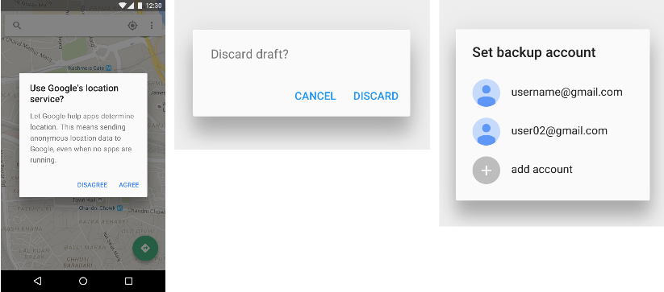
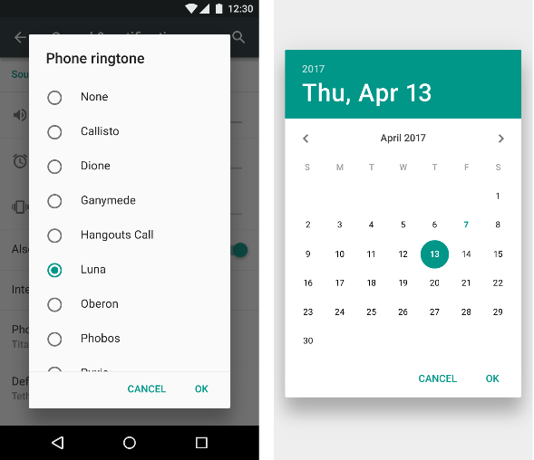
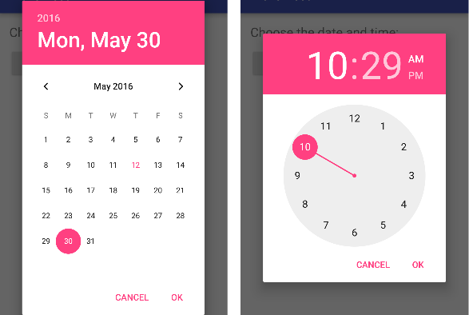
Dialogs
Dialog appears on top, interrupting the flow of activity
Require user action to dismiss
AlertDialog
TimePickerDialog
DatePickerDialog

Slide 64
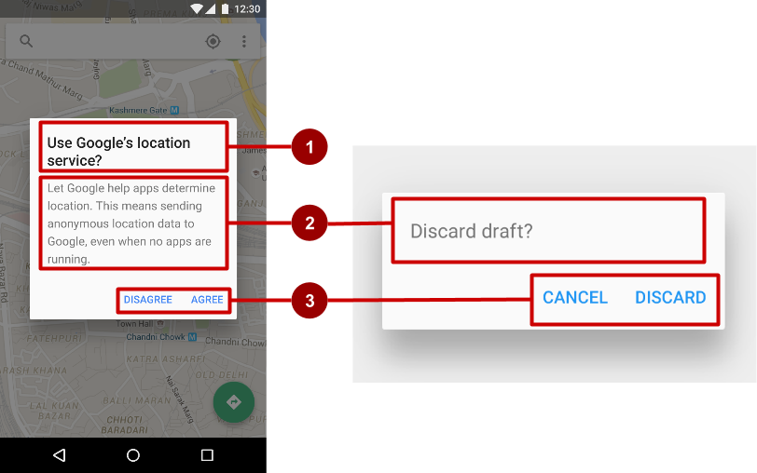
AlertDialog
AlertDialog can show:
Title (optional)
Content area
Action buttons
Notes:
Alerts are urgent interruptions, requiring acknowledgement, that inform the user about a situation as it occurs, or an action before it occurs (as in discarding a draft). You can provide buttons in an alert to make a decision. For example, an alert dialog might require the user to click Continue after reading it, or give the user a choice to agree with an action by clicking a positive button (such as OK or Accept), or to disagree by clicking a negative button (such as Cancel).
Use the AlertDialog subclass of the Dialog class to show a standard dialog for an alert. The AlertDialog class allows you to build a variety of dialog designs. An alert dialog can have the following regions (refer to the diagram below):
Title: A title is optional. Most alerts don’t need titles. If you can summarize a decision in a sentence or two by either asking a question (such as, “Discard draft?”) or making a statement related to the action buttons (such as, “Click OK to continue”), don’t bother with a title. Use a title if the situation is high-risk, such as the potential loss of connectivity, and the content area is occupied by a detailed message, a list, or custom layout.
Content area: The content area can display a message, a list, or other custom layout.
Action buttons: You should use no more than three action buttons in a dialog, and most have only two.

Slide 65
Build the AlertDialog
Use AlertDialog.Builder to build a standard alert dialog and set attributes:
public void onClickShowAlert(View view) {
AlertDialog.Builder alertDialog = new
AlertDialog.Builder(MainActivity.this);
alertDialog.setTitle("Connect to Provider");
alertDialog.setMessage(R.string.alert_message);
...
Notes:
The AlertDialog.Builder class provides the builder design pattern, which makes it easy to create an object from a class that has a lot of required and optional attributes and would therefore require a lot of parameters to build. Without this pattern, you would have to create constructors for combinations of required and optional attributes; with this pattern, the code is easier to read and maintain.
Use AlertDialog.Builder to build a standard alert dialog and set attributes on the dialog. Use setTitle() to set its title and setMessage() to set its message.
Note: If AlertDialog.Builder is not recognized as you enter it, you may need to add the following import statements to MainActivity.java:
import android.content.DialogInterface;
import android.app.AlertDialog;
The following creates the dialog object and sets the title (the string resource called alert_title) and message (the string resource called alert_message):
public void onClickShowAlert(View view) {
// Build the alert dialog.
AlertDialog.Builder alertDialog = new
AlertDialog.Builder(MainActivity.this);
// Set the dialog title.
alertDialog.setTitle("Connect to Provider");
// Set the dialog message.
alertDialog.setMessage(R.string.alert_message);
...

Slide 66
Add the button actions
alertDialog.setPositiveButton()
alertDialog.setNeutralButton()
alertDialog.setNegativeButton()
Notes:
Use the setPositiveButton() and setNegativeButton() methods of the AlertDialog.Builder class to set the button actions for the alert dialog. These methods require a title for the button (supplied by a string resource) and the DialogInterface.OnClickListener class that defines the action to take when the user presses the button:
You can add only one of each button type to an AlertDialog. For example, you can’t have more than one “positive” button.
You can also set a “neutral” button with setNeutralButton(). The neutral button appears between the positive and negative buttons. Use a neutral button, such as “Remind me later”, if you want the user to be able to dismiss the dialog and decide later.

Slide 67
alertDialog code example
alertDialog.setPositiveButton(
"OK", newDialogInterface.OnClickListener() {
public void onClick(DialogInterface dialog, int which) {
// User clicked OK button.
}
});
Same pattern for setNegativeButton() and setNeutralButton()

Slide 68
Pickers

Slide 69
Pickers
DatePickerDialog
TimePickerDialog

Slide 70
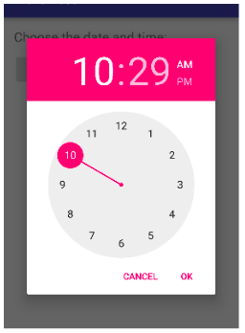
Pickers use fragments
Use DialogFragment to show a picker
DialogFragment is a window that floats on top of activity’s window

Slide 71
Introduction to fragments
A fragment is like a mini-activity within an activity
Manages its own own lifecycle.
Receives its own input events.
Can be added or removed while parent activity is running
Multiple fragments can be combined in a single activity
Can be reused in multiple activities

Slide 72
Creating a date picker dialog
Add a blank fragment that extends DialogFragment and implements DatePickerDialog.OnDateSetListener
In onCreateDialog() initialize the date and return the dialog
In onDateSet() handle the date
In Activity show the picker and add a method to use the date

Slide 73
Creating a time picker dialog
Add a blank fragment that extends DialogFragment and implements TimePickerDialog.OnTimeSetListener
In onCreateDialog() initialize the time and return the dialog
In onTimeSet() handle the time
In Activity, show the picker and add a method to use the time

Slide 74
Common Gestures

Slide 75
Touch Gestures
Touch gestures include:
long touch
double-tap
fling
drag
scroll
pinch
Don’t depend on touch gestures for app's basic behavior!

Slide 76
Detect gestures
Classes and methods are available to help you handle gestures.
GestureDetectorCompat class for common gestures
MotionEvent class for motion events

Slide 77
Detecting all types of gestures
Gather data about touch events.
Interpret the data to see if it meets the criteria for any of the gestures your app supports.
Read more about how to handle gestures in the Android developer documentation
Notes:
To detect all types of gestures, you need to perform two essential steps:
Gather data about touch events.
Interpret the data to see if it meets the criteria for any of the gestures your app supports.
The gesture starts when the user first touches the screen, continues as the system tracks the position of the user's finger(s), and ends by capturing the final event of the user's fingers leaving the screen. Throughout this interaction, an object of the MotionEvent class is delivered to onTouchEvent(), providing the details of every interaction. Your app can use the data provided by the MotionEvent to determine if a gesture it cares about happened.

Slide 78
Learn more
Input Controls
Drawable Resources
Floating Action Button
Radio Buttons
Specifying the Input Method Type
Handling Keyboard Input
Text Fields
Buttons
Spinners
Dialogs
Fragments
Input Events
Pickers
Using Touch Gestures
Gestures design guide

Slide 79
What's Next?
Concept Chapter: 4.1 C User Input Controls
Practical: 4. P Using Keyboards, Input Controls, Alerts, and Pickers

Slide 80
END

